Slide 1
Craving! ER Diagrams

Slide 2
Table of Contents
Conceptual ER Diagram of the entire application ……………………………………….……...Slide 3
Logical ER Diagram of the entire application…….……………………………………………...Slide 4
Logical ER Diagram of the tables for the features in scope for R1..…………………………..Slide 5
Logical ER Diagram of the tables for the features in scope for R2..…………………………..Slide 6
Revision notes……………………………………………………………………………………....Slide 7

Slide 3
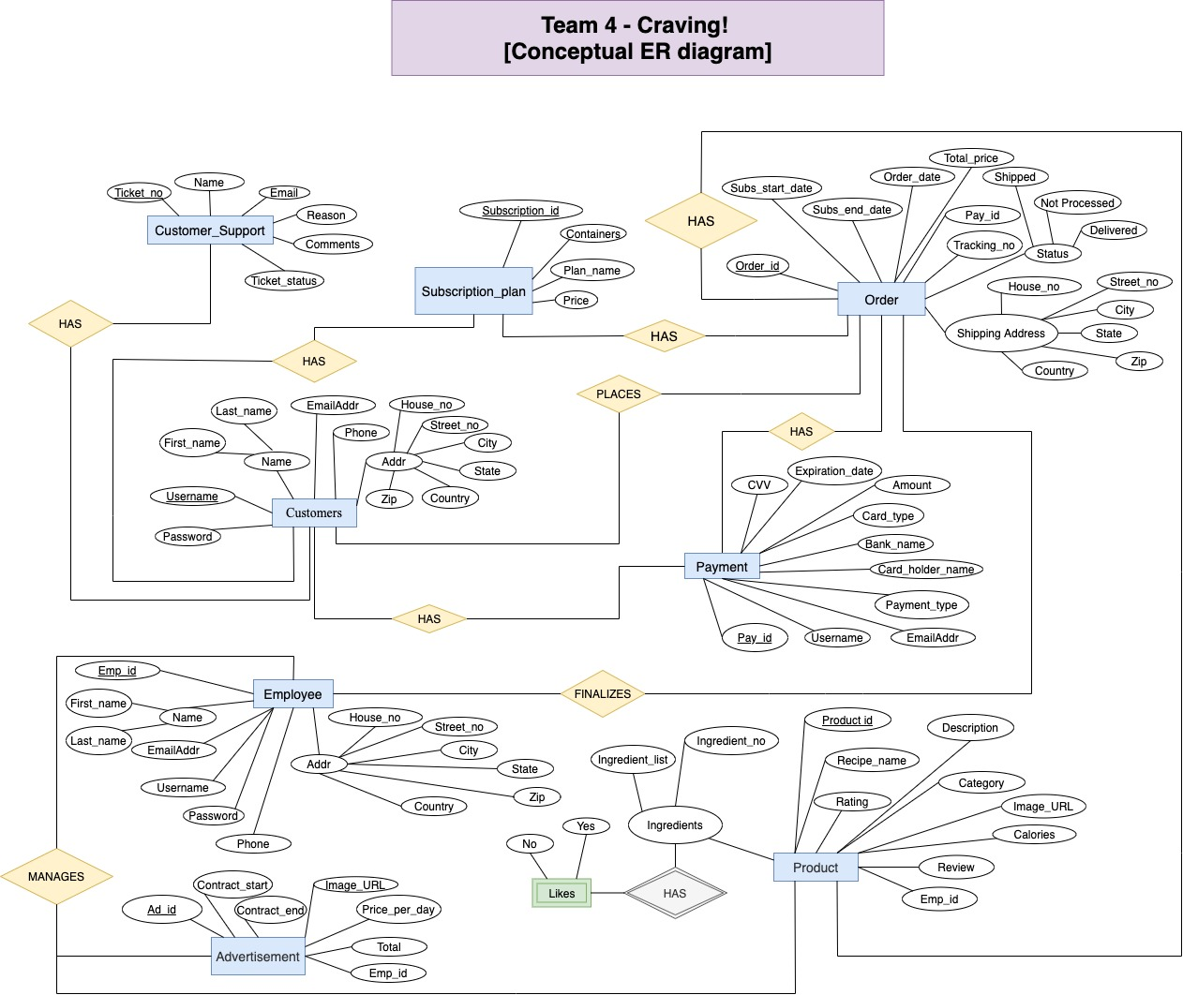

Slide 4
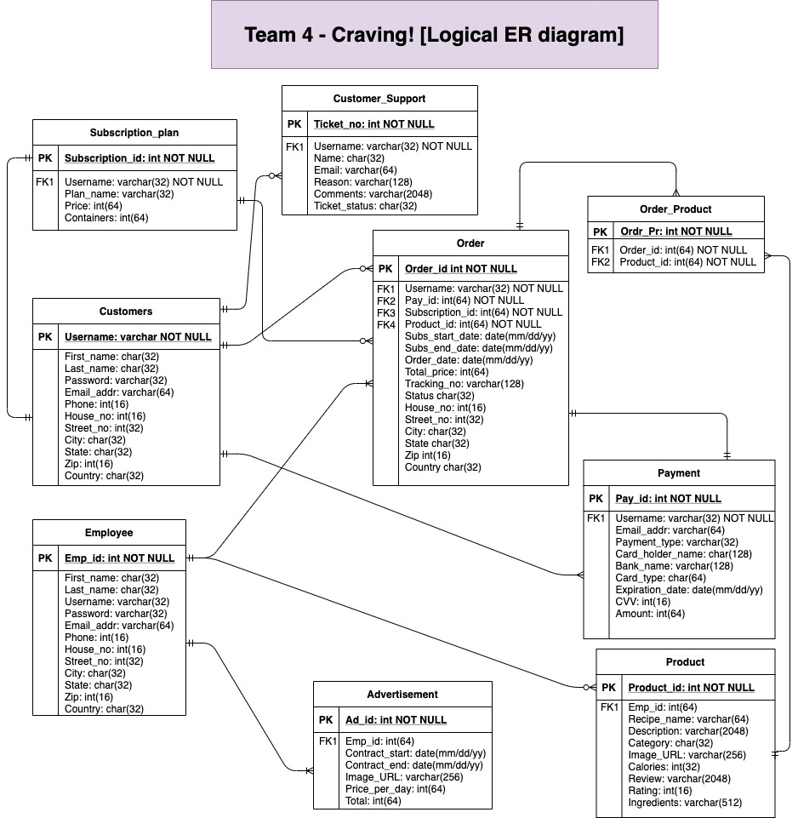

Slide 5
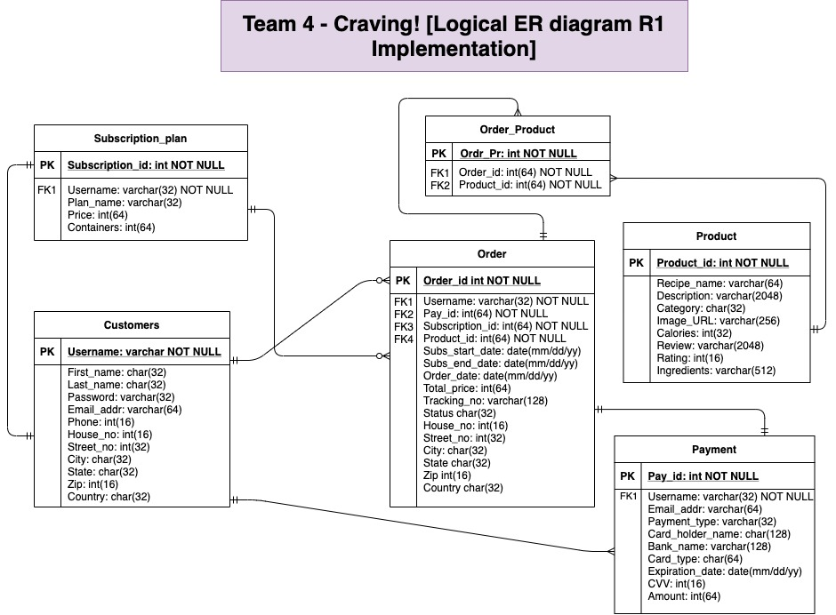

Slide 6
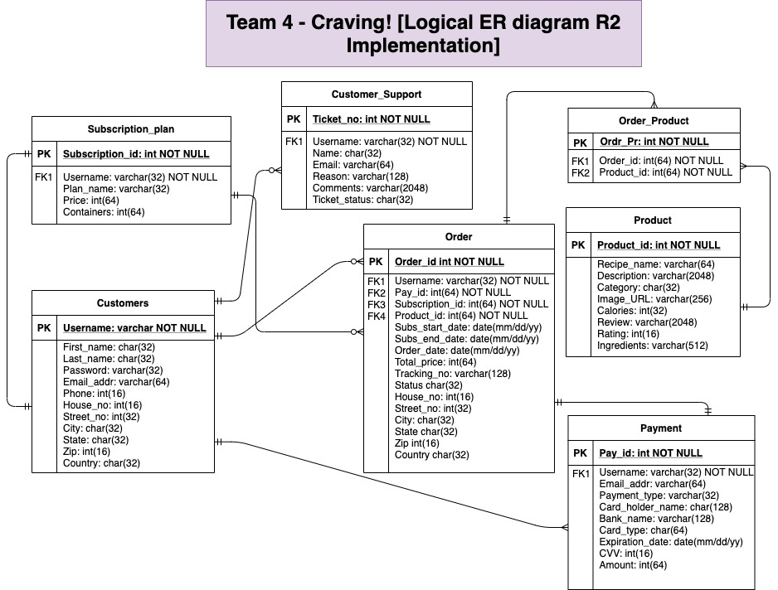

Slide 7
Revision Notes
Revision Date | Comments
02/24/2021 | Added the table of contents, slide 2 Inserted slide 6 to include the I1 and I2 features’ tables Inserted slide 7 to include the I3 and I4 features’ tables
03/19/2021 | Added the PK in the linkage table Fixed the position of the FK in the payment table
4/02/2021 | Added the Ticket Status to the Customer Support table
4/16/2021 | Added the FK to Product and Advertisement tables in the logical diagram

